Slide 1

Cytochrome P450 Drives a HIF-Regulated Behavioral Response to Reoxygenation by C. elegans
by Dengke K. Ma, Michael Rothe, Shu Zheng, Nikhil Bhatla, Corinne L. Pender, Ralph Menzel, and H. Robert Horvitz
Science
Volume 341(6145):554-558
August 2, 2013
Published by AAAS

Slide 2
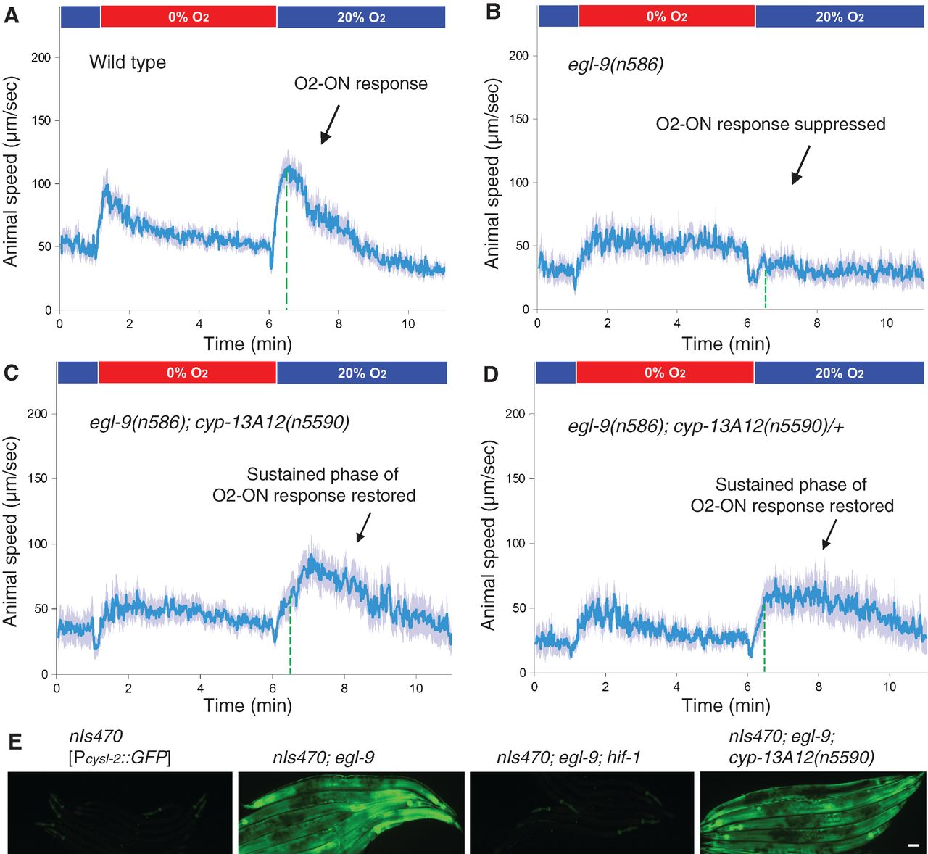
Fig. 1 n5590 suppresses the defect of egl-9 mutants in the O2-ON response.
Dengke K. Ma et al. Science 2013;341:554-558
Published by AAAS
Notes:
n5590 suppresses the defect of egl-9 mutants in the O2-ON response. (A) Speed graph of wild-type animals, showing a normal O2-ON response. Average speed values ± 2 SEM (blue) of animals (n > 50) are shown with step changes of O₂ between 20 and 0% at the indicated times. The mean speed within 0 to 120 s after O₂ restoration is increased relative to that before O₂ restoration (P < 0.01, one-sided unpaired t test). The dashed green line indicates the approximate boundary (30 s after reoxygenation) between the initial and sustained phases of the O2-ON response. (B) Speed graph of egl-9(n586) mutants, showing a defective O2-ON response. (C) Speed graph of egl-9(n586);cyp-13A12(n5590) mutants, showing a restored O2-ON response mainly in the sustained phase (right of the dashed green line). The mean speed within 30 to 120 s after O₂ restoration was signiﬁcantly higher than that of egl-9(n586) mutants (P < 0.01). (D) Speed graph of egl-9(n586); cyp-13A12(n5590)/+ mutants, showing a restored O2-ON response in the sustained phase. (E) hif-1 but not cyp-13A12(n5590) suppressed the expression of cysl-2::GFP by egl-9(n586) mutants. GFP fluorescence micrographs of five to seven worms aligned side by side carrying the transgene nIs470 [P_{cysl-2}::GFP] are shown. Scale bar, 50 μm.

Slide 3
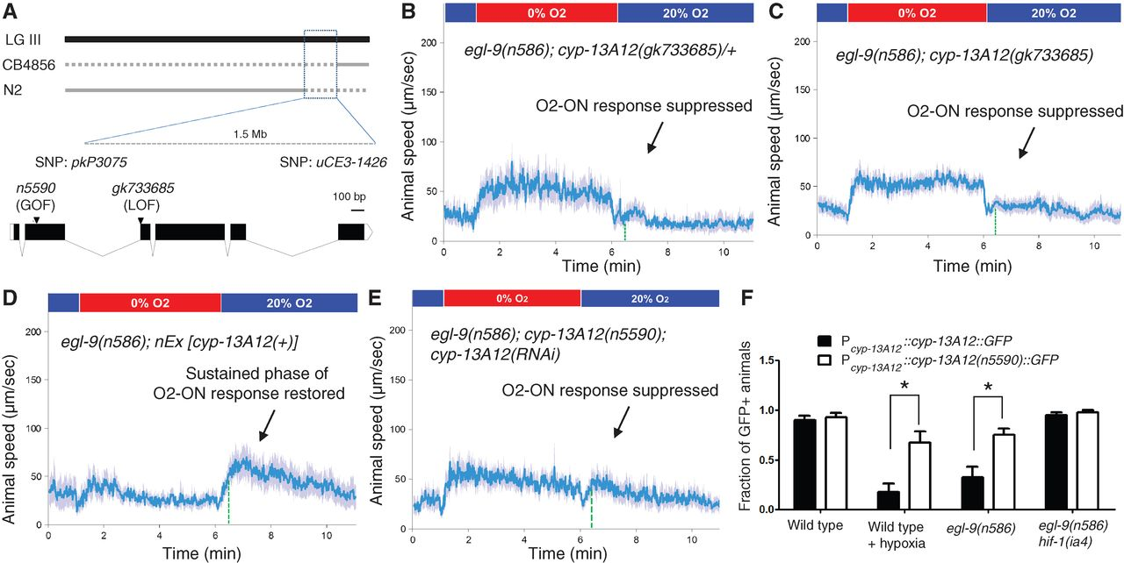
Fig. 2 n5590 is a gain-of-function allele of cyp-13A12.
Dengke K. Ma et al. Science 2013;341:554-558
Published by AAAS
Notes:
n5590 is a gain-of-function allele of cyp-13A12. (A) Genetic mapping positioned n5590 between the SNPs pkP3075 and uCE3-1426. Solid gray lines indicate genomic regions for which recombinants exhibited a defective O2-ON response, thus excluding n5590 from those regions. The locations of n5590 and gk733685 are indicated in the gene diagram of cyp-13A12. (B) Speed graph of egl-9(n586); cyp-13A12(gk733685)/+ animals, showing a defective O2-ON response. (C) Speed graph of egl-9(n586); cyp-13A12(gk733685) mutants, showing a defective O2-ON response. (D) Speed graph of egl-9(n586); nEx [cyp-13A12(+)] animals, showing a restored O2-ON response in the sustained phase (right of the dashed green line). (E) Speed graph of egl-9(n586);cyp-13A12(n5590); cyp-13A12(RNAi) animals, showing a suppressed O2-ON response. (F) Fractions of animals expressing CYP-13A12::GFP or CYP-13A12(n5590)::GFP [*P < 0.01, two-way analysis of variance (ANOVA) with Bonferroni test, n = 4].

Slide 4
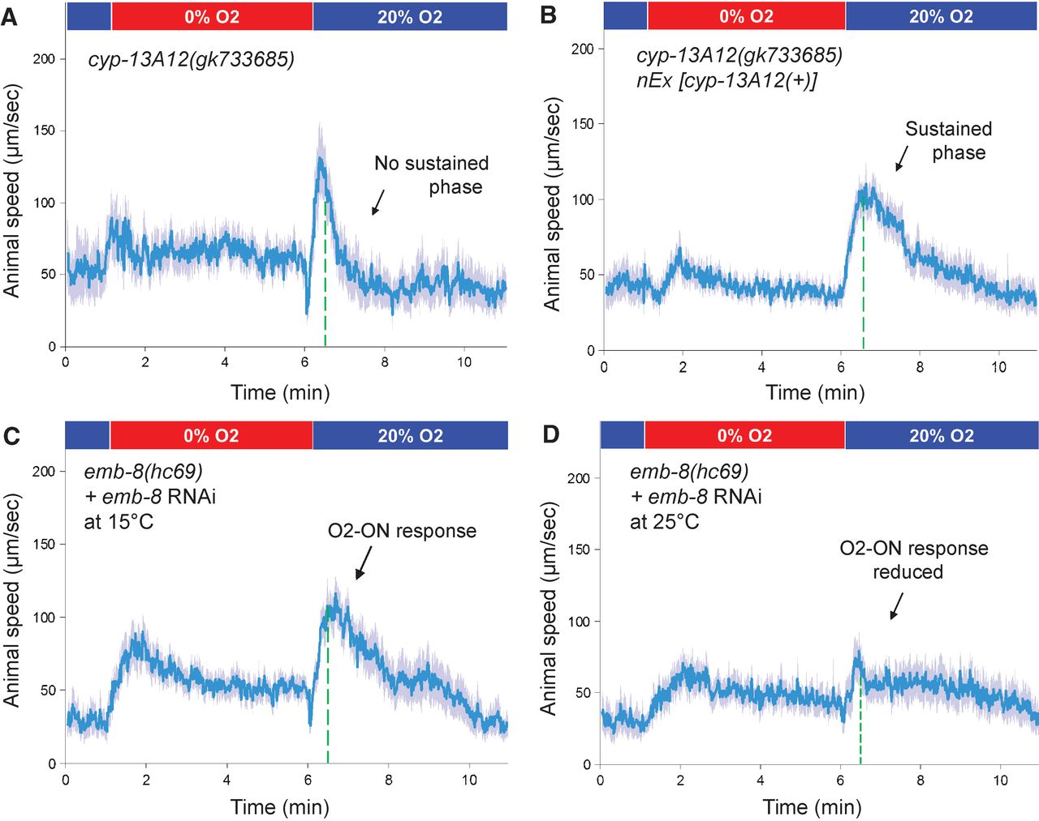
Fig. 3 Requirement of CYP-13A12 for a normal O2-ON response.
Dengke K. Ma et al. Science 2013;341:554-558
Published by AAAS
Notes:
Requirement of CYP-13A12 for a normal O2-ON response. (A) Speed graph of cyp-13A12(gk733685) loss-of-function mutants, showing an O2-ON response with a normal initial phase but a diminished sustained phase (left and right, respectively, of the dashed green line). (B) Speed graph of cyp-13A12(gk733685) mutants with a rescuing wild-type cyp-13A12 transgene, showing the O2-ON response with a normal initial phase and sustained phase. The mean speed within 30 to 120 s after O₂ restoration was higher than that of cyp-13A12(gk733685) mutants (P < 0.01, one-sided unpaired t test, n > 50). (C) Speed graph of emb-8(hc69) mutants grown at the permissive temperature of 15°C with simultaneous E. coli–feeding RNAi against emb-8, showing a normal O2-ON response. (D) Speed graph of emb-8(hc69) mutants grown post-embryonically at the restrictive temperature of 25°C with simultaneous E. coli–feeding RNAi against emb-8, showing a reduced O2-ON response.

Slide 5
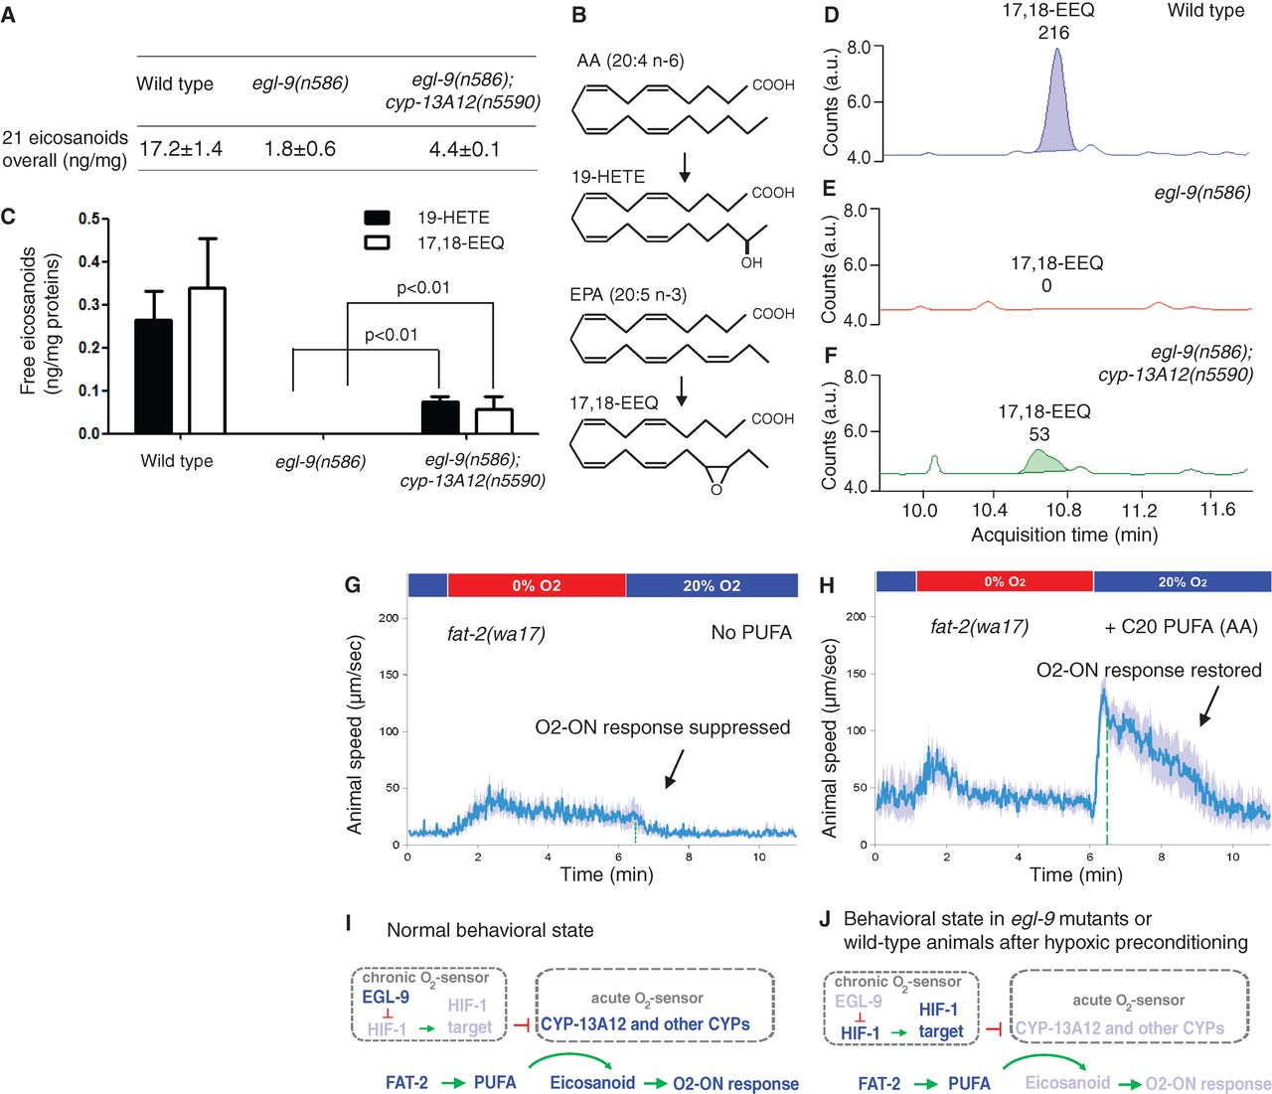
Fig. 4 Modulation of eicosanoid concentrations by EGL-9 and CYP-13A12.
Dengke K. Ma et al. Science 2013;341:554-558
Published by AAAS
Notes:
Modulation of eicosanoid concentrations by EGL-9 and CYP-13A12. (A) Overall levels of free eicosanoids, calculated by adding the values of the profiled 21 eicosanoids in the wild type and in the egl-9(n586) and egl-9(n586); cyp-13A12(n5590) strains. (B) Schematic illustrating the conversion of arachidonic acid (AA) to 19-HETE and of eicosapentaenoic acid (EPA) to 17,18-EEQ by CYPs. (C) Quantification of 19-HETE and 17,18-EEQ concentrations in the wild type and in egl-9(n586); cyp-13A12(n5590) and egl-9(n586) mutant strains. Amounts of free (membrane-unbound) forms of 17,18-EEQ and 19-HETE from extracts of age-synchronized young adult hermaphrodites are shown (P < 0.01, two-way ANOVA post hoc test, n = 3). Error bars are SEM. (D to F) Representative HPLC-MS traces indicating free 17,18-EEQ levels based on the spectrograms of three MS samples: (D) wild type, (E) egl-9(n586), and (F) egl-9(n586); cyp-13A12(n5590). Peaks of 17,18-EEQ at its transition m/z (mass-to-charge ratio) were measured and extracted (MassHunter). The x axis shows the retention time (minutes); the y axis shows the abundance (counts), with specific integral values over individual peaks indicated above each peak. (G) Speed graph of fat-2 mutants, showing a defective O2-ON response. Animals were supplemented with the solvents used in (H) as a control. (H) Speed graph of fat-2 mutants, showing the O2-ON response rescued by C20 PUFA (AA) supplementation. (I and J) Model of how EGL-9 and CYPs control the O2-ON response under (I) normoxic conditions and (J) conditions of hypoxic preconditioning or in egl-9 mutants (see text for details). Light blue indicates low protein activity, low amounts of eicosanoids, or a defective O2-ON response.

